Slide 1

Autonomous Traffic Intersection Management
Name | Mat
Nader Yahia | 2210026
Hassan
Sohan
Umer
Supervisors
Prof. Dr.rer.nat. Achim Rettberg
Prof.Dr.Ing Stefan Henkler

Slide 2
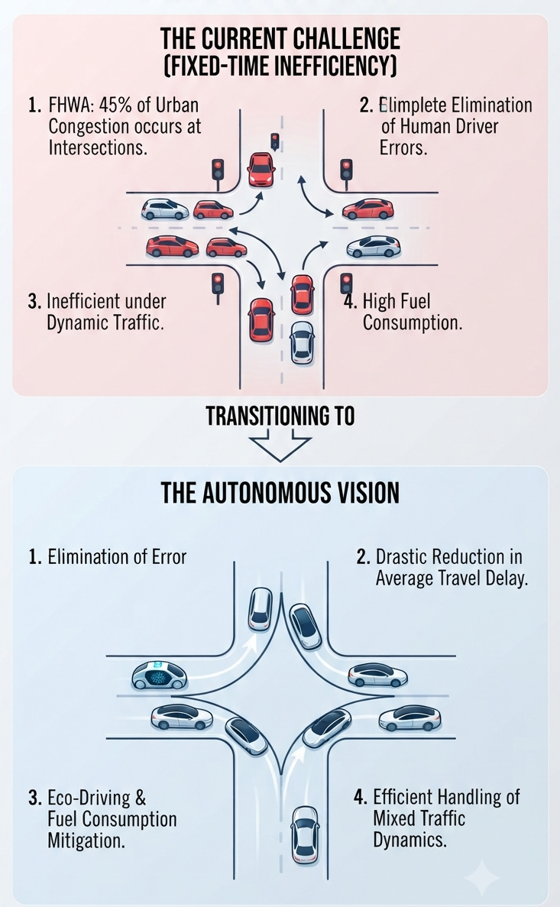
Motivation
FHWA, intersections cause about 45% of all urban traffic congestion.
Fixed-time traffic lights are inefficient under dynamic and heterogeneous traffic conditions.
Eco-Driving and Fuel Consumption Mitigation.
Complete Elimination of Human Driver Errors.
Drastic Reduction in Average Travel Delay.
Resilient Handling of Mixed Traffic Dynamics.
[1]-[3]
Notes:
1-making them the main bottlenecks in city road networks.
2-Drastic Reduction in Average Travel Delay

Slide 3
Requirments
Functional Core
Detect vehicle state (V2X + sensors).
Maintain intersection queue and global state.
Detect conflicts between vehicle paths.
Assign safe time-space reservations.
Control entry + execution of vehicles.
Handle emergency priority requests (Future work).
Safety Requirements
No collision in intersection zones→ mutual exclusion of Q1–Q4.
No deadlock in system→ system always progresses.
No starvation→ every vehicle eventually gets service.
Real-time bounded response→ scheduling within time limits.
Safe emergency handling→ priority without violating safety (Future work).
[4]

Slide 4
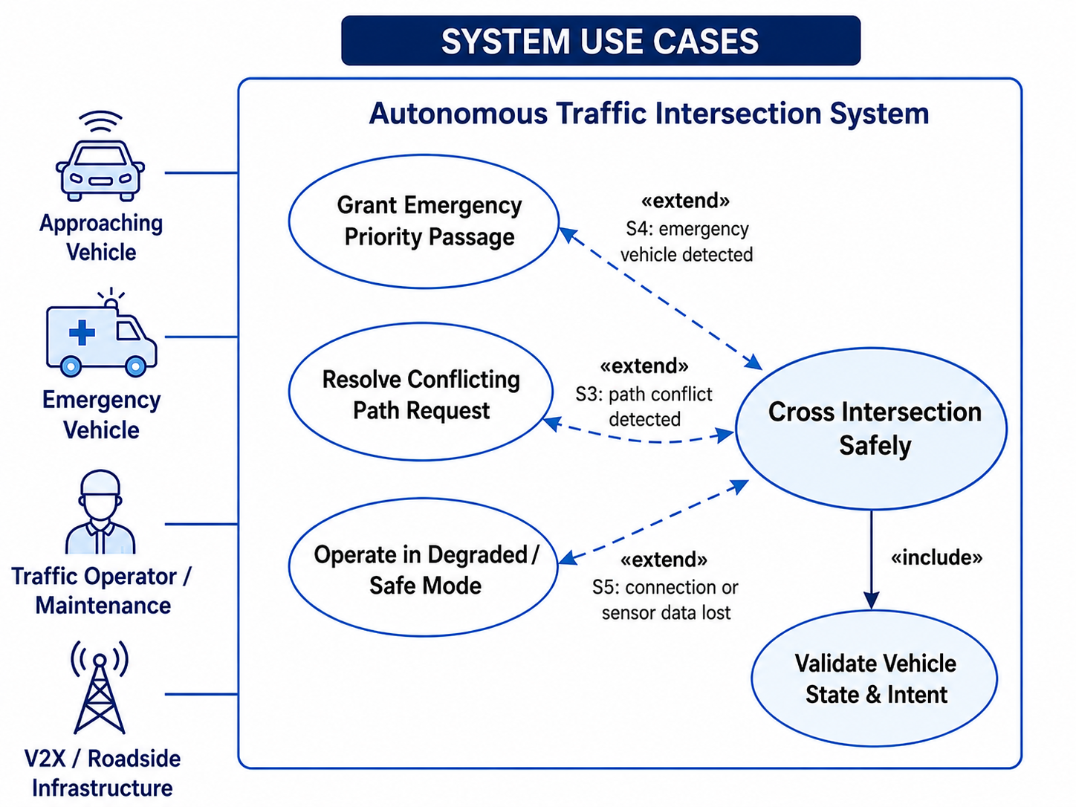
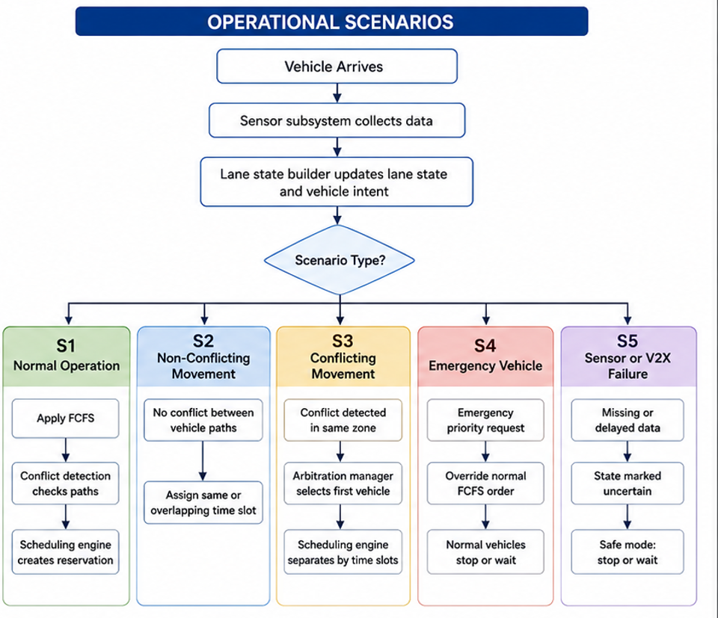
Use Cases
Reservation Request
Conflict Check
Grant / Wait Decision
Src: Image Genrated by ChatGPT-5.5

Slide 5
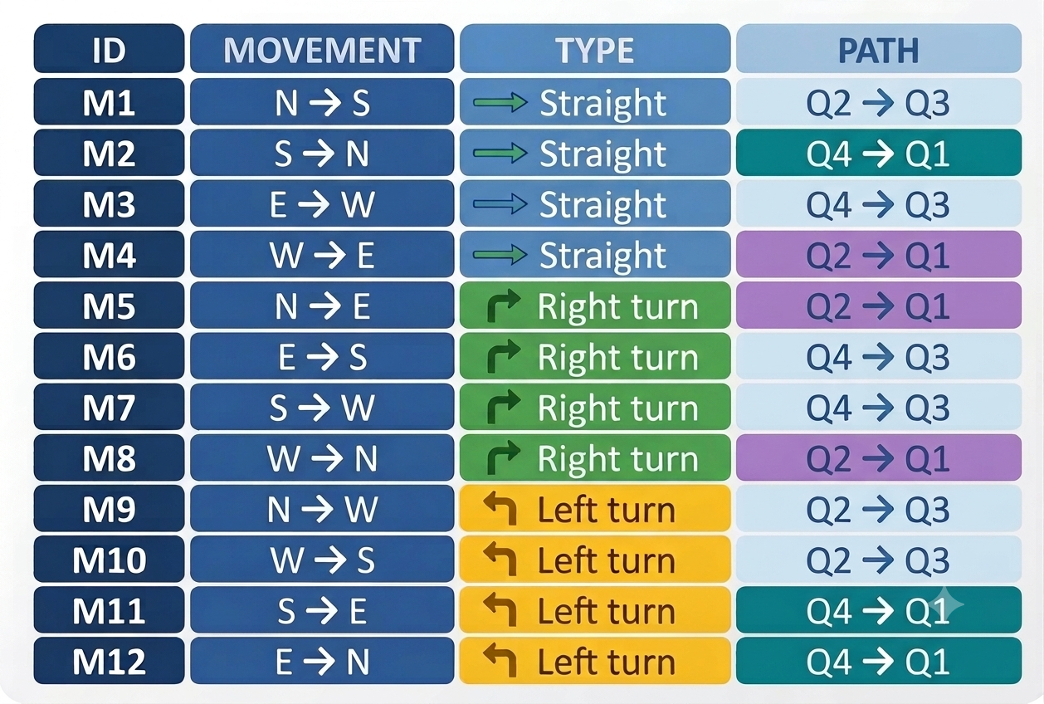
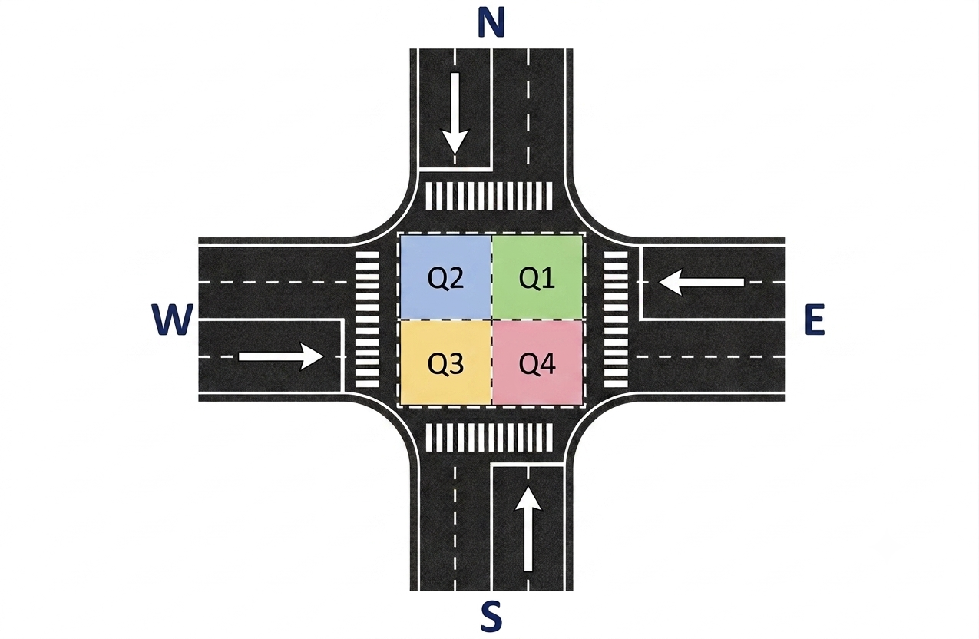
Intersection Trajectory
Trajectory Mapping: Groups 12 maneuvers (M1–M12) into standard straight or turning paths.
Spatial Resource Allocation: Links paths to quadrant sequences (Q1–Q4) for collision avoidance.
Conflict Identification: Flags overlapping paths (e.g., M1, M9, M10 sharing Q2,Q3) to spot bottlenecks.
Notes:
Trajectory Mapping: Discretizes 12 directional maneuvers (M1 to M12) into standardized straight and turning paths.
Spatial Resource Allocation: Links each movement to specific quadrant sequences (Q1 to Q4) to establish collision-avoidance logic.
Conflict Identification: Isolates overlapping path dependencies (e.g., M1, M9, and M10 all demanding Q2 \rightarrow Q3) to highlight scheduling bottlenecks.

Slide 6
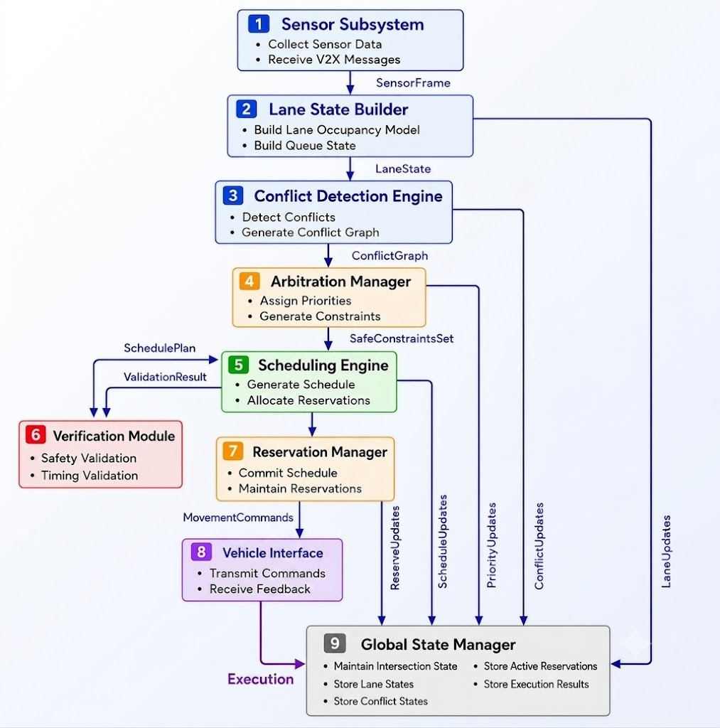
System Architecture

Slide 7
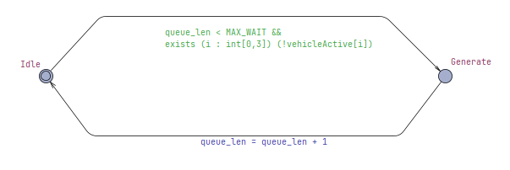
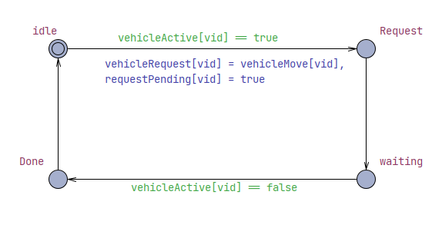
UPPAAL Model
VehicleGenerator
Vehicle (Agent Model)
Generates vehicle requests.
Assigns movement type.
Activates vehicles.
Represent vehicle lifecycle.
Toggles the activation flag.
Preserving routing data.
Notes:
1- A-Slot Allocation: Assigns the lowest open ID (i = 0 to 3) to the incoming vehicle.
B-State Reset: Activates the vehicle agent, maps its request, and resets its wait timer to 0. Cost Weighting: Sets cost = 1 for straight paths (M1–M4) and cost = 2 for turns.
C-Maneuver Rotation: Increments the global tracking counter, cycling from 1 to 12.
2- A-State Management: Advances the vehicle instance through a simple deterministic
B-Liveness Notification: Toggles the activation flag (vehicleActive[vid] = true) to alert the core scheduler that a vehicle occupies the queue.
C-Buffer Isolation: Stores its unique structural target in an internal variable
Future work: EmergencyHandlerOverrides normal scheduling when needed

Slide 8
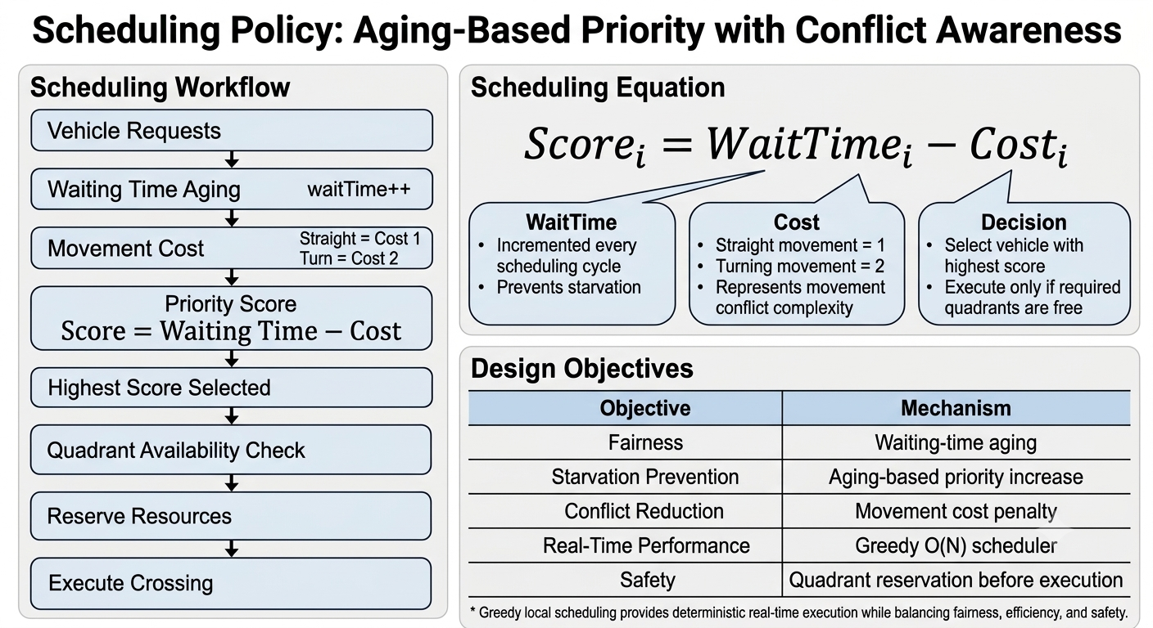
UPPAAL Model
Scheduling policy
A Reservation-based , conflict-aware scheduling policy selects vehicles for safe intersection access considering fairness and real-time constraints.
Notes:
Future work: EmergencyHandler Overrides normal scheduling when needed
Achieve safe, deterministic, and real-time scheduling while balancing fairness and efficiency under strict intersection constraints.
We verify the system using CTL properties in UPPAAL to ensure safety (no collisions), liveness (progress), and real-time constraints under all possible execution traces.
Reservation-based search through queueO(N)
Fully parallel FPGA reservation engineApproximately O(1) scheduling latency

Slide 9
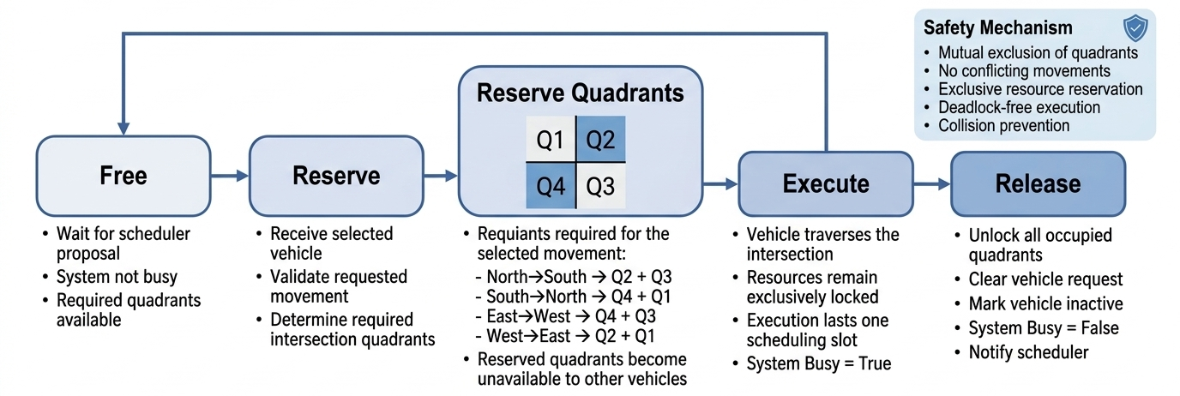
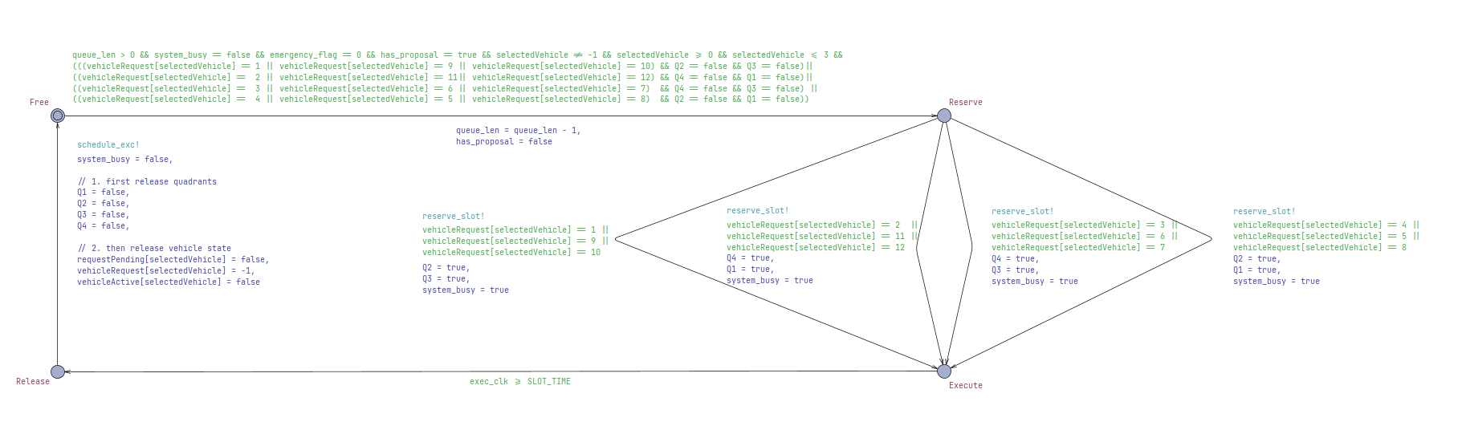
UPPAAL Model
Intersection Controller
Notes:
Future work: EmergencyHandler Overrides normal scheduling when needed
Achieve safe, deterministic, and real-time scheduling while balancing fairness and efficiency under strict intersection constraints.
We verify the system using CTL properties in UPPAAL to ensure safety (no collisions), liveness (progress), and real-time constraints under all possible execution traces.

Slide 10
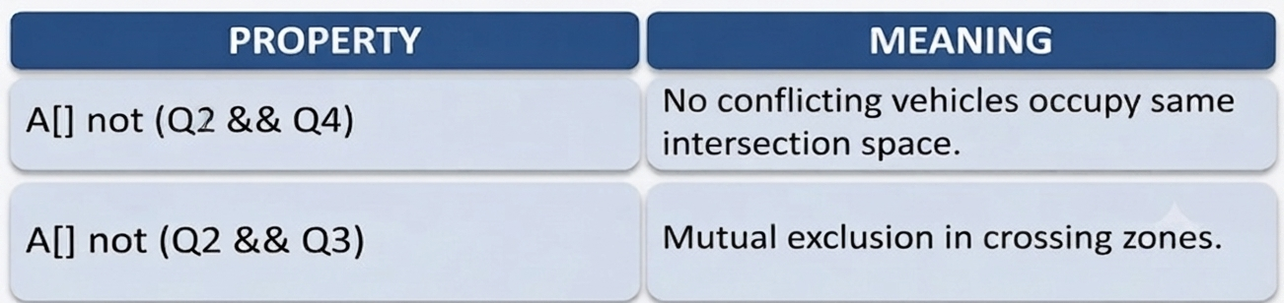
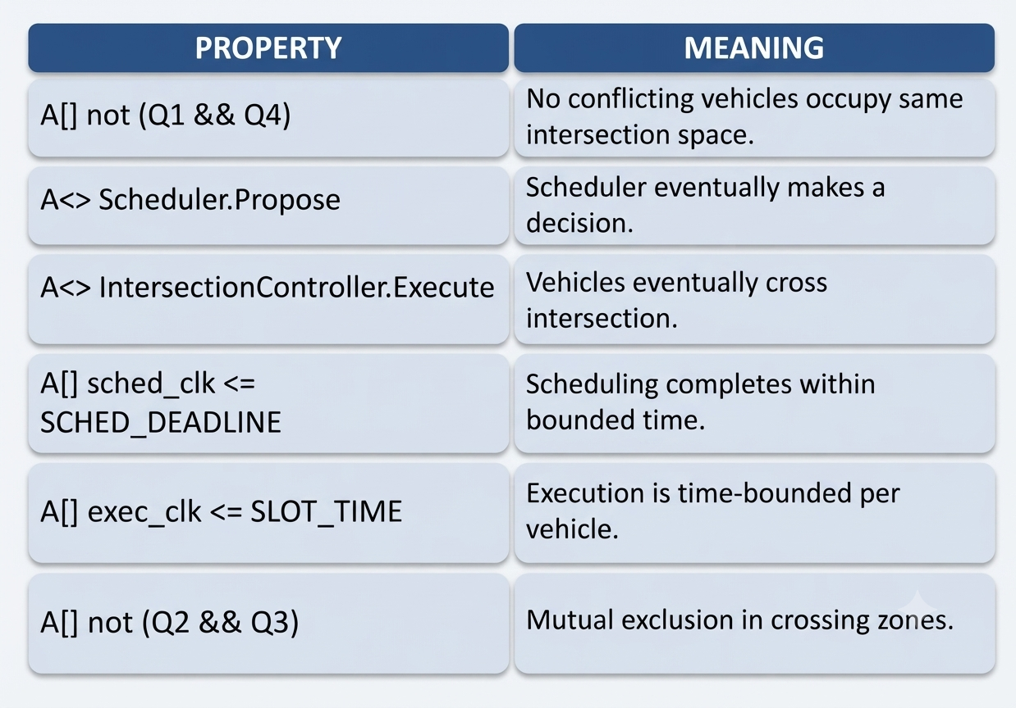
Verification
Objective
Ensure the system is:
safety (no collisions).
Liveness (progress guaranteed).
Deadlock-free.
Real-time compliant.
Safety Properties

Slide 11
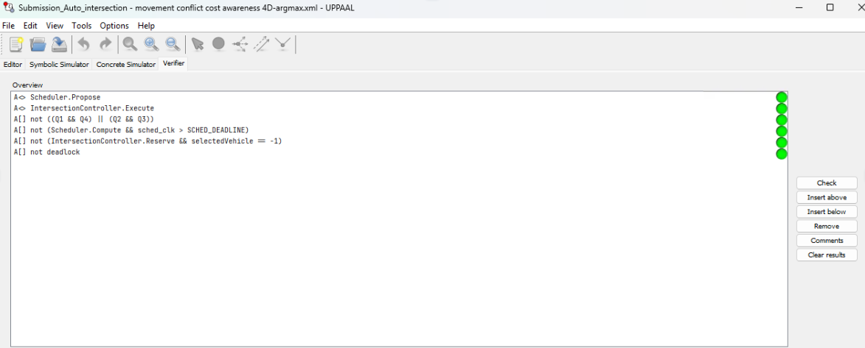
Verification

Slide 12
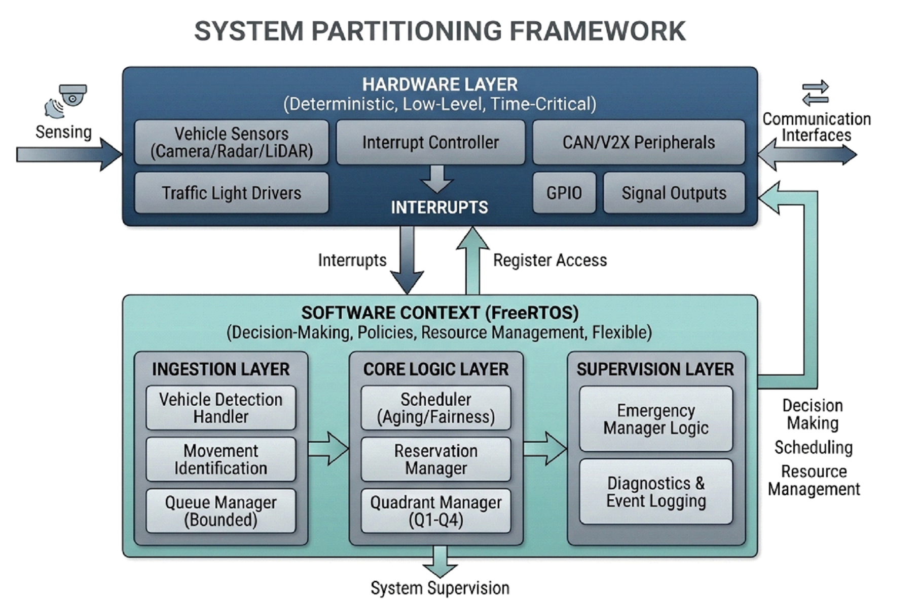
System Partitioning
Notes:
We can say edge deployment a sa title

Slide 13
System Partitioning
ARM Processor
FreeRTOS
FPGA Fabric
HW‑centric
Hybrid
AXI / high‑speed
interconnect bus
• Quadrant logic Q1–Q4
• Conflict matrix
• Reservation arbiter
• SLOT_TIME FPGA timer
EmergencyHandler
ARM + FPGA override
• Scheduler
• Queue Manager
• Task Manager
• V2X Communication
• Emergency Policy
Sensing / V2X
communication interfaces
Interrupts +
register access
Co‑design result: Flexible Scheduling + Deterministic Parallel Conflict Checking.
Notes:
Software Allocations:
Movement Identification: Evolving movement tracking logic requires flexible software implementation.
Queue Management: Dynamic data structures are easier to implement and modify.
Scheduler & Reservation: Fairness algorithms and availability checks are easier to verify.
Quadrant Manager: Occupancy states utilize simple, highly flexible, low-load software bitmasks.
Diagnostics & Logging: Event tracking and statistics are naturally software-based responsibilities.
Hybrid Allocations (Controllers, Emergency, Communication)
Division of Labor: Software decides logic and protocols; hardware drives physical outputs.

Slide 14
FreeRTOS Realization
1. TASK DECOMPOSITION
Hierarchical execution by priority
2. INTER-TASK COMMUNICATION
Protecting shared spatial resources
HIGHEST PRIO
Queues (N/S/E/W)
Buffer incoming FCFS request structures safely.
enqueue(), dequeue()
EmergencyTask — System override
void EmergencyTask(void *pvParam)
HIGH PRIO
SchedulerTask — FCFS decision
void SchedulerTask(void *pvParam)
Mutexes
Ensure atomic state checks and spatial quadrant reservations.
xSemaphoreCreateMutex()
HIGH PRIO
IntersectionManagerTask — Quadrant auth
void MonitorTask(void *pvParam)
Binary Semaphores
Instantly wake scheduler task upon vehicle request arrival.
xSemaphoreCreateBinary()
MEDIUM PRIO
V2XReceiverTask — Ingest requests
void V2XReceiverTask(void *pvParam)
Event Groups
Manage global state bitmasks (Normal vs. Emergency override).
xEventGroupCreate()
MEDIUM PRIO
FPGAInterfaceTask — Hardware sync
void FPGAInterfaceTask(void *pvParam)
Notes:
We can say edge deployment a sa title

Slide 15
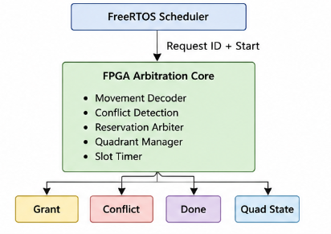
FPGA Core Realization
Implemented Modules:
Movement decoder converts request ID into required intersection quadrants.
Conflict detection checks if requested quadrants are already occupied.
Reservation arbiter grants access only when no conflict exists.
Slot timer automatically releases reserved quadrants after crossing.
Done signal notifies FREETROS that the request is completed.

Slide 16
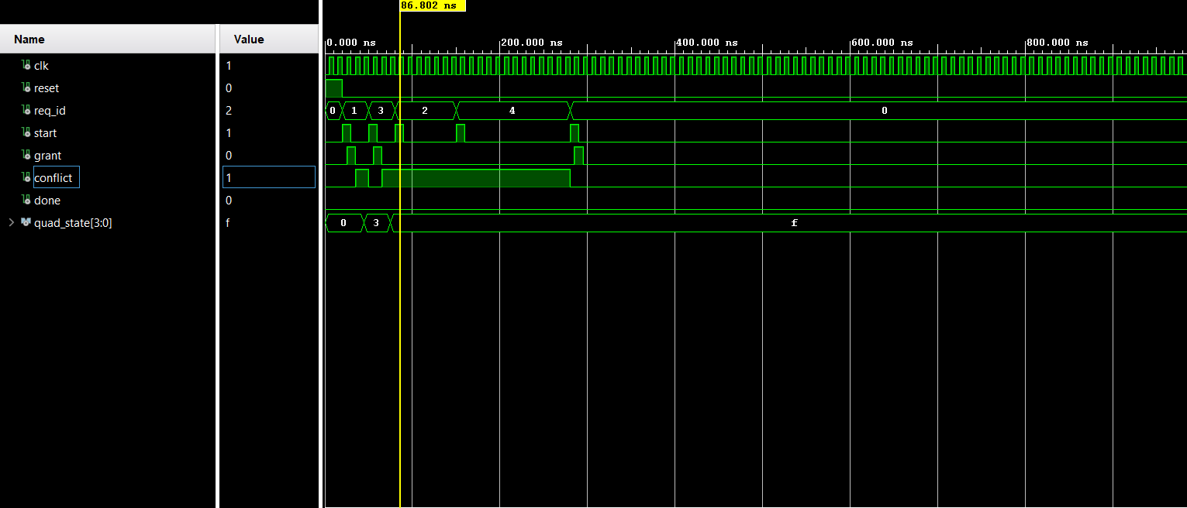
FPGA Core Realization

Slide 17
Conclusion
This project presented a real-time autonomous intersection controller based on a heterogeneous SoC architecture.
The system combines:
FreeRTOS (ARM): vehicle request handling, FCFS-based queue management, and emergency control
FPGA (VHDL): deterministic reservation, conflict detection, and quadrant-based execution control
AXI-Lite Interface: memory-mapped communication between software and hardware
Key Outcomes
Safe and collision-free intersection management using quadrant reservation
Deterministic real-time behavior ensured by FPGA acceleration
Scalable scheduling model using queue-based reservation logic
Clear separation of responsibilities:
Software = decision + scheduling
Hardware = safety + execution enforcement

Slide 18
Refereneces
[1] Z. Zhong, M. Nejad, and E. E. Lee, "Autonomous and Semiautonomous Intersection Management: A Survey," IEEE Intelligent Transportation Systems Magazine, vol. 13, no. 1, pp. 53–70, 2021. https://doi.org/10.1109/mits.2020.3014074Cited by: 109
[2] A. Abbas-Turki et al., "Autonomous Intersection Management: Optimal Trajectories and Efficient Scheduling," Sensors, vol. 23, no. 3, p. 1509, 2023. https://doi.org/10.3390/s23031509Cited by: 29
[3] B. Li, Y. Zhang, N. Jia, and X. Peng, "Autonomous Intersection Management over Continuous Space: A Microscopic and Precise Solution via Computational Optimal Control," IFAC-PapersOnLine, vol. 53, no. 2, pp. 17071–17076, 2020. https://doi.org/10.1016/j.ifacol.2020.12.1611Cited by: 28

Slide 19
Q & A

Slide 20
System Partitioning
Software Allocations:
HW/SW partitioning
Movement Identification.
Queue Management
Scheduler & Reservation
Quadrant Manager
Diagnostics & Logging
Principle
HW = deterministic, time‑critical interfacing
SW = flexible decisions, scheduling and policies
HW
F1 Detection + F10 Clock
Sensors, timers and interrupts handle physical timing signals.
Hybrid Allocations (Controllers, Emergency, Communication)
Division of Labor: Software decides logic and protocols; hardware drives physical outputs.
SW
F2–F6 + F11
Movement logic, queues, scheduler, quadrant state, reservation and logging.
HYB
F7 + F8 + F9
Software decisions with hardware outputs, detection and communication.
[2][3]

Slide 21
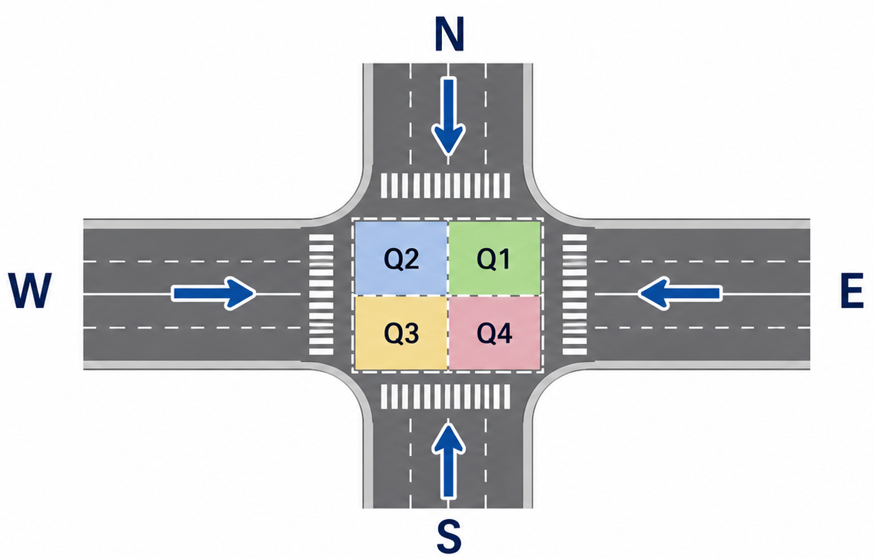
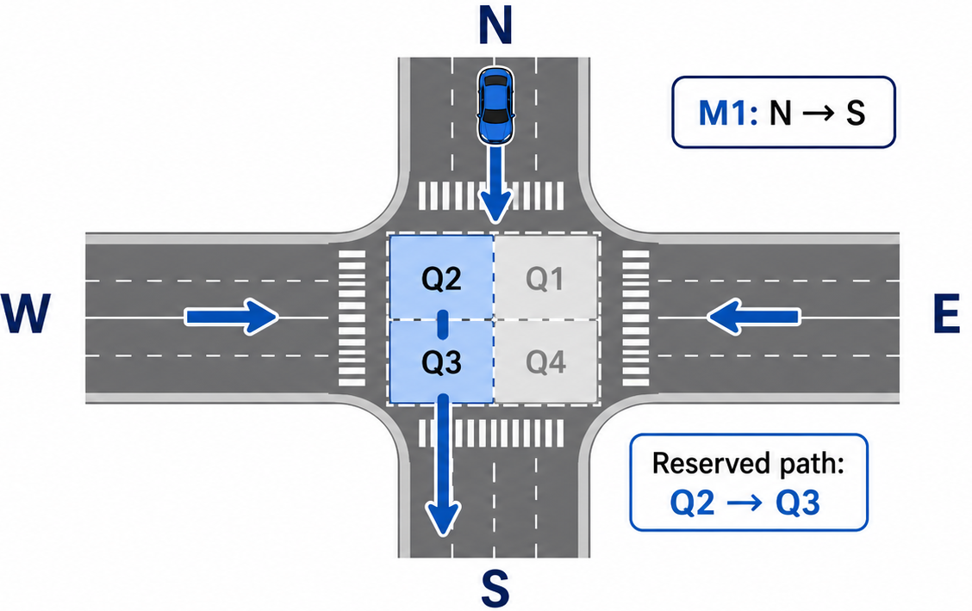
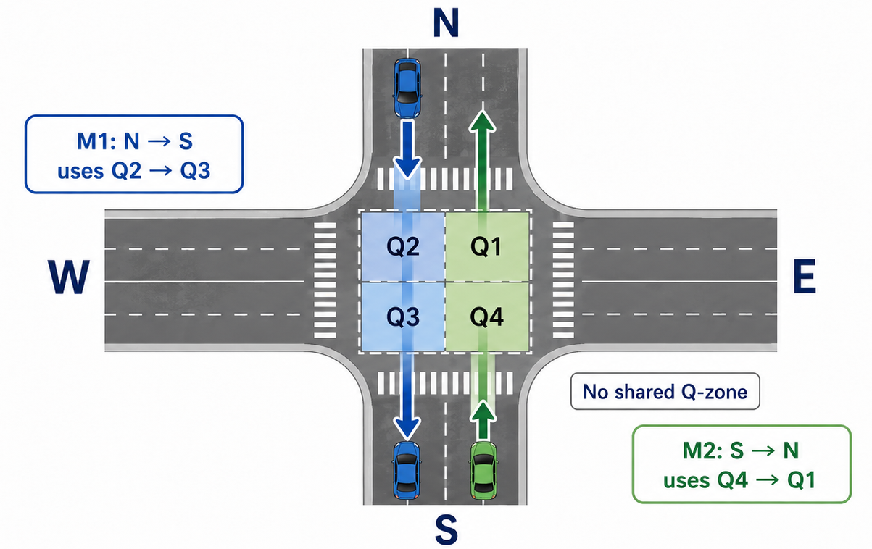
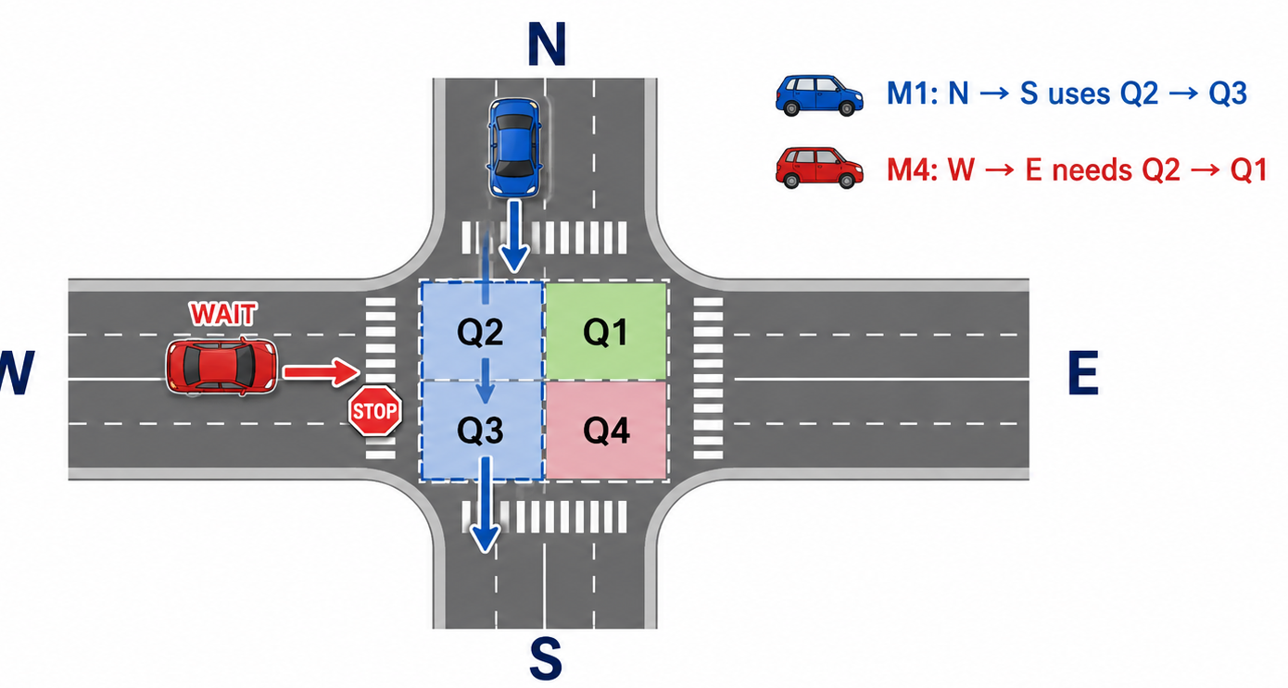
Q-Zone Reservation Logic
Src: Image Genrated by ChatGPT-5.5

Slide 22
UPPAAL Model
System Templates
VehicleGenerator
Generates vehicle requests dynamically
Assigns movement type + activates vehicles
Vehicle (Agent Model)
Represents vehicle lifecycle
idle → request → waiting → done
Scheduler
Computes priority using aging + cost
Selects selectedVehicle
Produces scheduling decision
IntersectionController
Reserves intersection quadrants (Q1–Q4)
Executes movement safely
Releases resources after execution
Notes:
Future work: EmergencyHandlerOverrides normal scheduling when needed

Slide 23
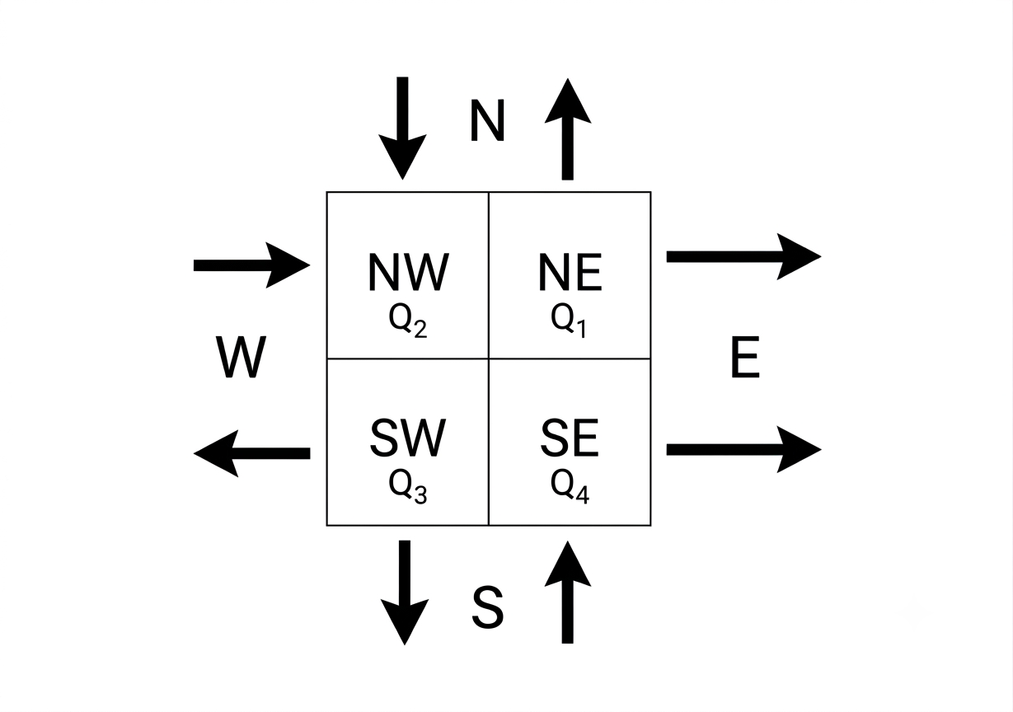
Appendix

Slide 24
Verification
Objective
Ensure the system is:
safe (no collisions)
live (progress guaranteed)
deadlock-free
real-time compliant
Safety Properties
Property | Meaning
A[] not (Q1 && Q4) | No conflicting vehicles occupy same intersection space
A[] not (Q2 && Q3) | Mutual exclusion in crossing zones
A[] system_busy imply !(Q1 && Q2 && Q3 && Q4) | Intersection cannot be in invalid full-state overlap

Slide 25
Problem Statement
Traditional traffic systems suffer from:
static signal timing → inefficient utilization
high waiting times under variable traffic load
limited adaptability to autonomous vehicles
lack of global coordination between vehicles
Core Challenge
dynamically schedules vehicles.
ensures collision-free intersection access.
satisfies real-time constraints.
is implementable on embedded systems.
Project Objectives
[1][2]

Slide 26
Motivation
Urban congestion is concentrated at intersections, making them major bottlenecks in transportation networks.
Fixed-time traffic lights are inefficient under dynamic and heterogeneous traffic conditions (Inefficient traffic flow).
Autonomous vehicles enable cooperative intersection management beyond signal-based control.
Road intersections are high-risk collision areas, where vehicles from multiple directions compete for the same conflict space.
This motivates the development of a safe, real-time, and verifiable intersection control system that ensures:
collision avoidance
improved traffic throughput
embedded real-time feasibility
[1][2]

Slide 27
UPPAAL Model
Scheduling policy
A reservation-based, conflict-aware scheduling policy selects vehicles for safe intersection access while ensuring fairness and real-time constraints.
Triggered when queue_len > 0
Computes: score = waitTime − cost
Selects vehicle with highest score
Output: selectedVehicle
Trade-off Dimension | Design Choice | Benefit | Limitation
Fairness vs Efficiency | Aging (waitTime) + cost-aware scoring | Prevents starvation, prioritizes waiting vehicles | May select less optimal routes
Optimality vs Real-Time | Greedy single-step selection | Bounded computation time, predictable behavior | No global optimization or future prediction
Safety vs Throughput | Strict quadrant reservation (Q1–Q4) | Collision-free execution guarantee | Limits parallel vehicle movement
Notes:
Future work: EmergencyHandler Overrides normal scheduling when needed
Achieve safe, deterministic, and real-time scheduling while balancing fairness and efficiency under strict intersection constraints.
We verify the system using CTL properties in UPPAAL to ensure safety (no collisions), liveness (progress), and real-time constraints under all possible execution traces.

Slide 28
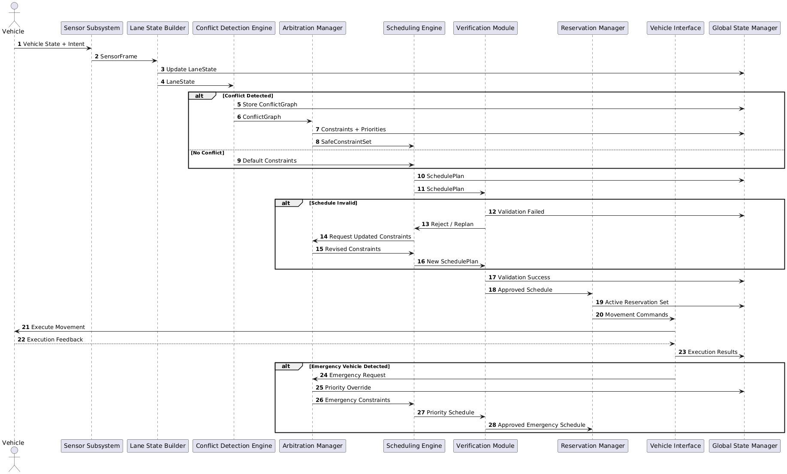
System Workflow

Slide 29
Verification
Objective
Ensure the system is:
safe (no collisions)
live (progress guaranteed)
deadlock-free
real-time compliant
Safety Properties
Property | Meaning
A[] not (Q1 && Q4) | No conflicting vehicles occupy same intersection space
A[] not (Q2 && Q3) | Mutual exclusion in crossing zones
A[] system_busy imply !(Q1 && Q2 && Q3 && Q4) | Intersection cannot be in invalid full-state overlap

Slide 30
Verification
Liveness Properties (Progress)
Property | Meaning
A<> Scheduler.Propose | Scheduler eventually makes a decision
A<> IntersectionController.Execute | Vehicles eventually cross intersection
Real-Time Constraints
Property | Meaning
A[] sched_clk <= SCHED_DEADLINE | Scheduling completes within bounded time
A[] exec_clk <= SLOT_TIME | Execution is time-bounded per vehicle
Notes:
UPPAAL model guarantees that every scheduling decision results in a collision-free, time-bounded, and eventually progressing execution sequence.

Slide 31
UPPAAL Model
Scheduling policy
A reservation-based, conflict-aware scheduling policy selects vehicles for safe intersection access considering fairness and real-time constraints.
Triggered when queue_len > 0
Computes: score = waitTime − cost
Selects vehicle with highest score
Output: selectedVehicle
Trade-off Dimension | Design Choice | Benefit | Limitation
Fairness vs Efficiency | Aging (waitTime) + cost-aware scoring | Prevents starvation, prioritizes waiting vehicles | May select less optimal routes
Optimality vs Real-Time | Greedy single-step selection | Bounded computation time, predictable behavior | No global optimization or future prediction
Safety vs Throughput | Strict quadrant reservation (Q1–Q4) | Collision-free execution guarantee | Limits parallel vehicle movement
Notes:
Future work: EmergencyHandler Overrides normal scheduling when needed
Achieve safe, deterministic, and real-time scheduling while balancing fairness and efficiency under strict intersection constraints.
We verify the system using CTL properties in UPPAAL to ensure safety (no collisions), liveness (progress), and real-time constraints under all possible execution traces.

